Slide 1
AVR Microcontroller
Microprocessor Course
Chapter 6
AVR ADVANCED ASSEMBLY LANGUAGE PROGRAMMING
Aban 1401

Slide 2
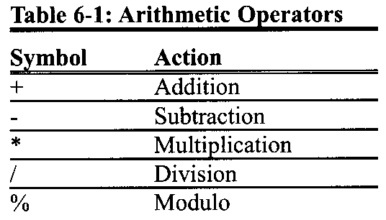
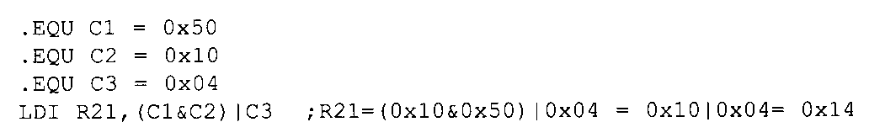
AVR ADVANCED ASSEMBLY LANGUAGE PROGRAMMING 6.1 : INTRODUCING SOME MORE ASSEMBLER DIRECTIVES
Arithmetic and logic expressions with constant values
The AVR Studio IDE supports logic operations between expressions as well.
For example, in the following program R21 is loaded with 0x14:

Slide 3
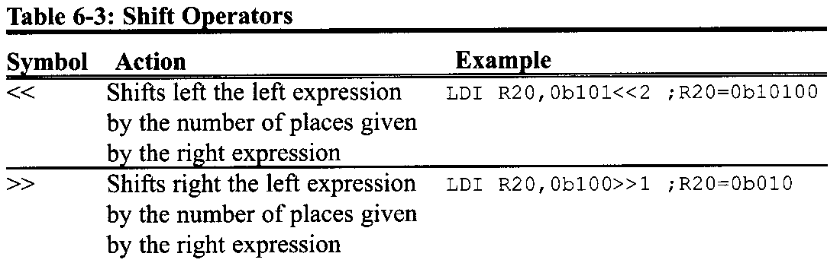
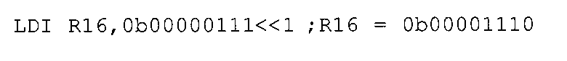
AVR ADVANCED ASSEMBLY LANGUAGE PROGRAMMING 6.1 : INTRODUCING SOME MORE ASSEMBLER DIRECTIVES
In Table 6-3 you see the shift operators, which are very useful. They shift left and right a constant value.
For example, the following instruction loads theR20 register with 0b00001110:
Notes:
In Table 6-3 you see the shift operators, which are very useful. They shift left and right a constant value.

Slide 4
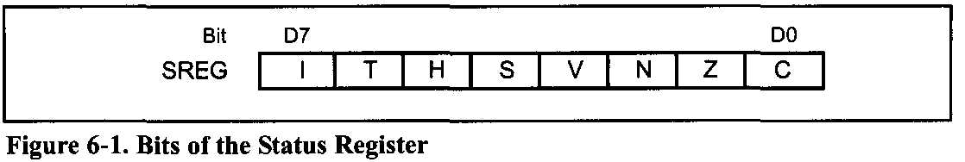
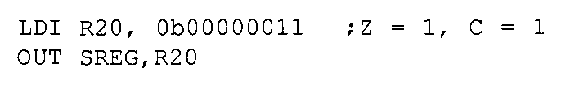
AVR ADVANCED ASSEMBLY LANGUAGE PROGRAMMING 6.1 : INTRODUCING SOME MORE ASSEMBLER DIRECTIVES
One of the uses of shift operators is for initializing the registers. For example suppose we want to set the Z and C bits of the SREG (Status Register) register and clear the others. Look at Figure 6-1.
If we load 0b00000011 to SREG the task will be done:
In this example, we calculated the 0b00000011 number by looking at Figure 6-1.

Slide 5
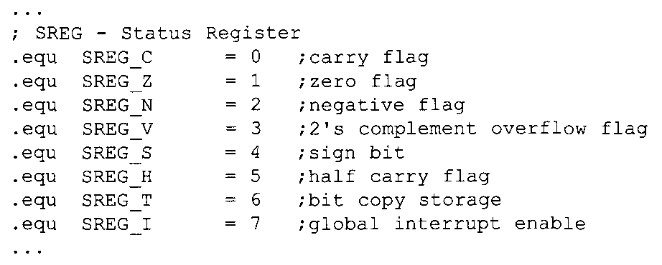
AVR ADVANCED ASSEMBLY LANGUAGE PROGRAMMING 6.1 : INTRODUCING SOME MORE ASSEMBLER DIRECTIVES
But imagine you are writing a program and you want to do the same task; you have to open the datasheet or a reference book to see the structure of the SREG register. To make the task simpler, the names of the register bits are defined in the header files of each AVR microcontroller. For example, in M32DEF.INC there are the following lines of code:

Slide 6
AVR ADVANCED ASSEMBLY LANGUAGE PROGRAMMING 6.1 : INTRODUCING SOME MORE ASSEMBLER DIRECTIVES
So, we can use the names of the bits instead of remembering the structure of the registers or finding them in the datasheet. For example, the following program sets the Z flag of the SREG register and clears the other bits:
As another example, the following program sets the V and S flags of SREG:
In Example 6-1, you see the usage of the directives in I/O port programming.

Slide 7
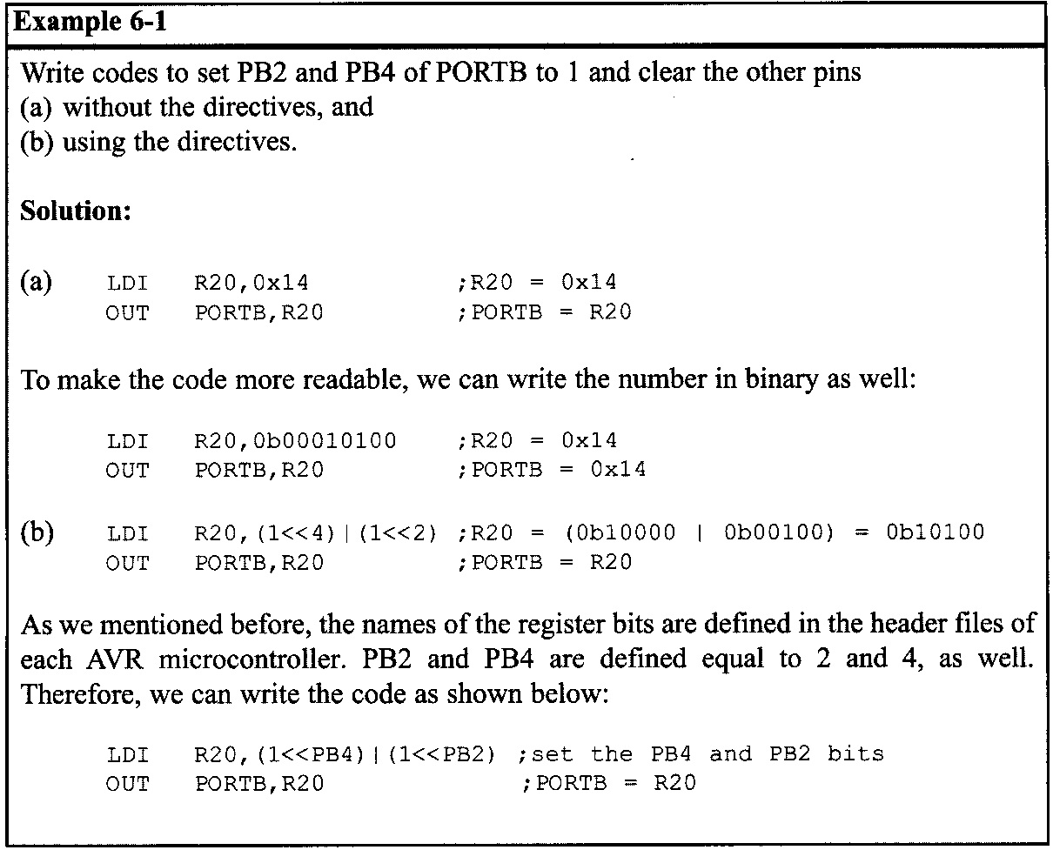
AVR ADVANCED ASSEMBLY LANGUAGE PROGRAMMING 6.1 : INTRODUCING SOME MORE ASSEMBLER DIRECTIVES

Slide 8
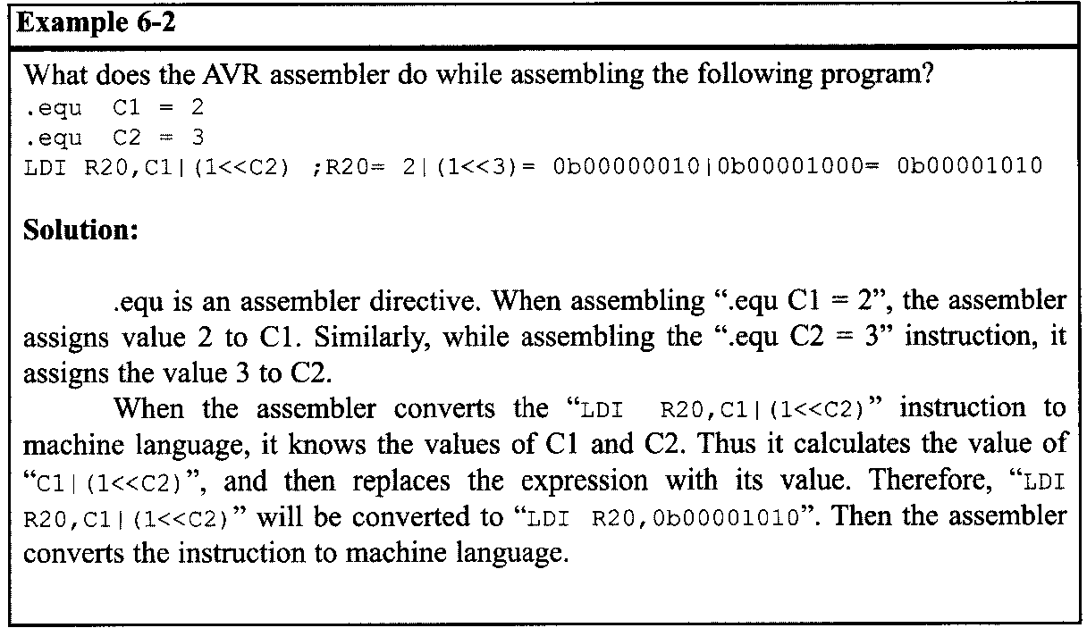
AVR ADVANCED ASSEMBLY LANGUAGE PROGRAMMING 6.1 : INTRODUCING SOME MORE ASSEMBLER DIRECTIVES
Notice that when the assembler wants to convert a code to machine language it substitutes all of the assembler directives with their equivalent values. Thus, using the directives has no side effects on the performance of our code but rather makes our code more readable.

Slide 9
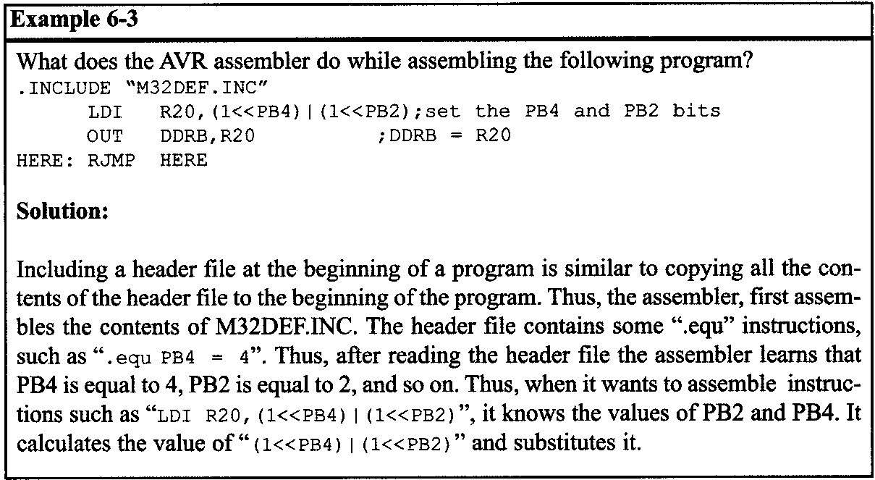
AVR ADVANCED ASSEMBLY LANGUAGE PROGRAMMING 6.1 : INTRODUCING SOME MORE ASSEMBLER DIRECTIVES

Slide 10
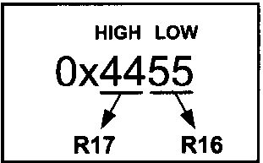
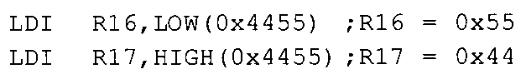
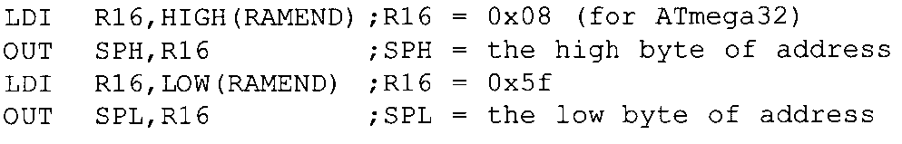
AVR ADVANCED ASSEMBLY LANGUAGE PROGRAMMING 6.1 : INTRODUCING SOME MORE ASSEMBLER DIRECTIVES
HIGH( ) and LOW( ) functions
The HIGH( ) and LOW( ) functions give the higher and the lower bytes of a 16-bit value. For example, in the following program 0x55 and 0x44 are loaded into R16 and R17, respectively:
In Chapter 2, we used the following instructions to make the stack pointer refer to the last location of the memory:
Notes:
In Chapter 2, we used the following instructions to make the stack pointer refer to the last location of the memory:

Slide 11
AVR ADVANCED ASSEMBLY LANGUAGE PROGRAMMING REGISTER AND DIRECT ADDRESSING MODES
REGISTER AND DIRECT ADDRESSING MODES
The CPU can access data in various ways. The data could be in a register, or in memory, or provided as an immediate value. These various ways of accessing data are called addressing modes. These ways can be categorized into the following groups:
1. Single-Register (Immediate)
2. Register
3. Direct
4. Register indirect
5. Flash Direct
6. Flash Indirect

Slide 12
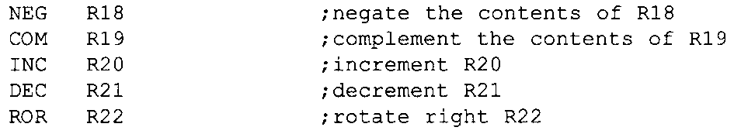
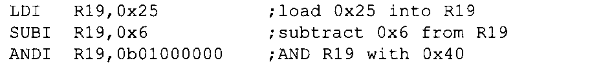
AVR ADVANCED ASSEMBLY LANGUAGE PROGRAMMING 6.1 : INTRODUCING SOME MORE ASSEMBLER DIRECTIVES
Single-register (immediate) addressing mode
In this addressing mode, the operand is a register.
In some of the instructions there is also a constant value with the register operand.
The constant value is sometimes referred to as immediate data since the operand comes immediately after the opcode when the instruction is assembled; and the addressing mode is referred to as immediate addressing mode in some microcontrollers.

Slide 13
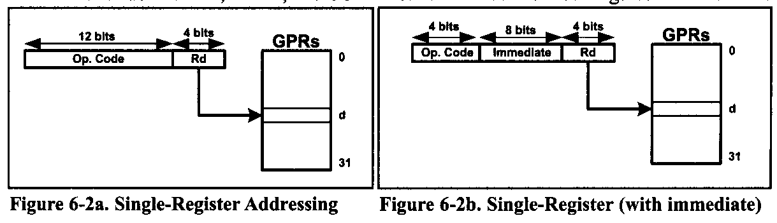
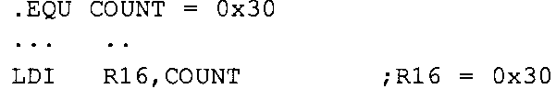
AVR ADVANCED ASSEMBLY LANGUAGE PROGRAMMING 6.1 : INTRODUCING SOME MORE ASSEMBLER DIRECTIVES
This addressing mode can be used to load data into any of the R16-R31 general purpose registers. The immediate addressing mode is also used for arithmetic and logic instructions. Note that the letter "I" in instructions such as LDI, ANDI, and SUBI means “Immediate.“
We can use the .EQU directive to access immediate data, as shown below.

Slide 14
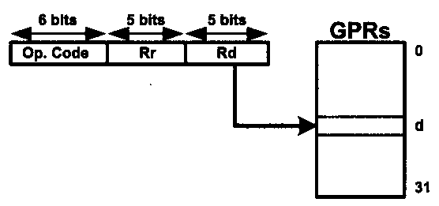
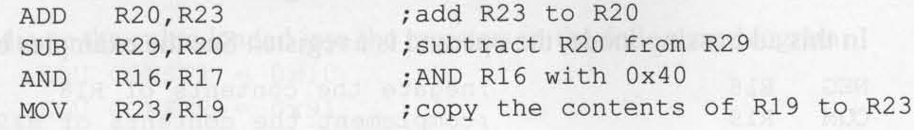
AVR ADVANCED ASSEMBLY LANGUAGE PROGRAMMING 6.1 : INTRODUCING SOME MORE ASSEMBLER DIRECTIVES
Two-register addressing mode
Two-register addressing mode involves the use of two registers to hold the data to be manipulated.
Examples of two-register addressing mode are as follows:

Slide 15
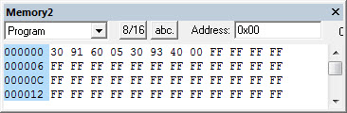
AVR ADVANCED ASSEMBLY LANGUAGE PROGRAMMING 6.1 : INTRODUCING SOME MORE ASSEMBLER DIRECTIVES
Direct addressing mode
The entire data memory can be accessed using either direct or register indirect addressing modes. In direct addressing mode, the operand data is in a RAM memory location whose address is known, and this address is given as a part of the instruction.
The two instructions use direct addressing mode. lf we dissect the opcode we see that the addresses are embedded in The instruction

Slide 16
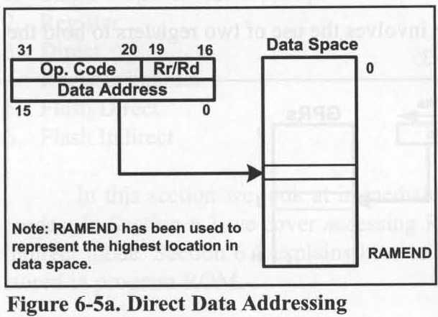
AVR ADVANCED ASSEMBLY LANGUAGE PROGRAMMING 6.1 : INTRODUCING SOME MORE ASSEMBLER DIRECTIVES
As shown in Figure 6-5a, the address field is a 16-bit address and can take values from $0000-$FFFF. Of course, it is much easier to use names instead of addresses in the program, and we have seen many examples of them in the last few chapters.

Slide 17

AVR ADVANCED ASSEMBLY LANGUAGE PROGRAMMING 6.1 : INTRODUCING SOME MORE ASSEMBLER DIRECTIVES
It must be noted that data memory does not support immediate addressing mode. In other words, to move data into internal RAM or to I/O registers, we must first move it to a GPR (R16-R31), and then move it from the GPR to the data memory space using the STS instruction.

Slide 18

AVR ADVANCED ASSEMBLY LANGUAGE PROGRAMMING 6.1 : INTRODUCING SOME MORE ASSEMBLER DIRECTIVES
I/O direct addressing mode
To access the I/O registers there is a special mode called I/O direct addressing mode. The I/O direct addressing mode can address only the standard I/O registers. The IN and OUT instructions use this addressing mode. Examine the following instruction, which copies the contents of PINB to PORTC:

Slide 19
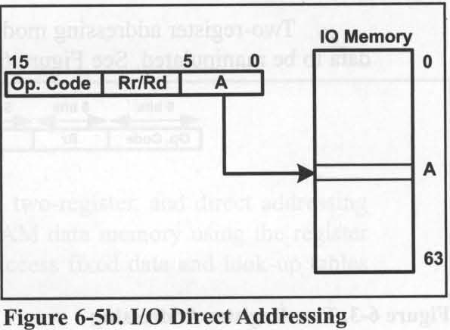
AVR ADVANCED ASSEMBLY LANGUAGE PROGRAMMING 6.1 : INTRODUCING SOME MORE ASSEMBLER DIRECTIVES
As shown in Figure 6-5b, the address field is a 6-bit address and can take values from $00 to $3F, which is from 00 to 63 in decimal. So, it can address the entire standard I/O register memory space.

Slide 20

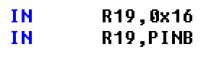
AVR ADVANCED ASSEMBLY LANGUAGE PROGRAMMING 6.1 : INTRODUCING SOME MORE ASSEMBLER DIRECTIVES
The AVR registers for Ports A, B, and so on are part of the group of registers commonly referred to as I/O registers. There are many I/O registers and they are widely used. The I/O registers can be accessed by their names or by their addresses. For example, PINB has address 0x16, and PORTC the address $15, as shown in Table 6-4. Notice how the following pairs of instructions mean the same thing:

Slide 21
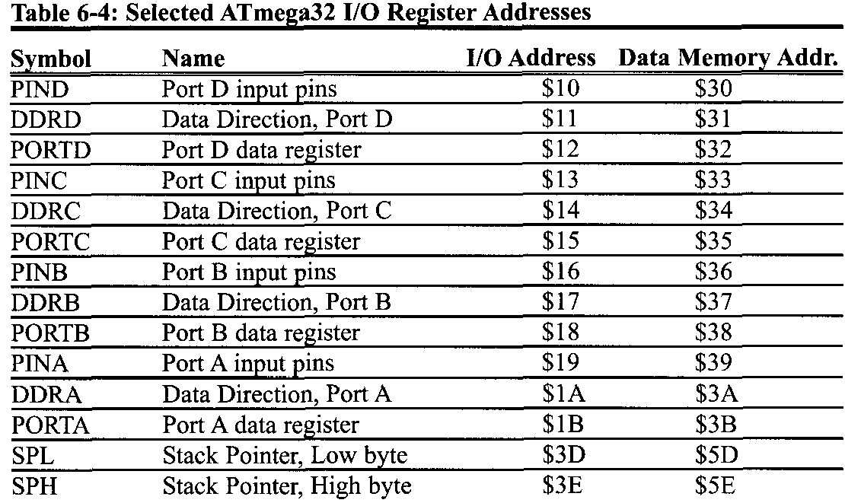
AVR ADVANCED ASSEMBLY LANGUAGE PROGRAMMING 6.1 : INTRODUCING SOME MORE ASSEMBLER DIRECTIVES

Slide 22
AVR ADVANCED ASSEMBLY LANGUAGE PROGRAMMING 6.1 : INTRODUCING SOME MORE ASSEMBLER DIRECTIVES
Table 6-4 lists some of the AVR I/O registers and their addresses. The following points should be noted about the addresses of I/O registers:
As shown in Figures 2-3 and 2-4, the addresses between $20 and $5F of the data space have been assigned to standard I/O registers in all of the AVRs. These I/O registers have two addresses: I/O address and data memory address. The I/O address is used when we use the I/O direct addressing mode, while the data memory address is used when we use the direct addressing mode; in other words, the standard I/O registers can be accessed using both the direct addressing and the I/O addressing modes.
Some AVRs have less than 64 I/O registers. So, some locations of the standard I/O memory are not used by the I/O registers. The unused locations are reserved and must not be used by the AVR programmer.

Slide 23

AVR ADVANCED ASSEMBLY LANGUAGE PROGRAMMING 6.1 : INTRODUCING SOME MORE ASSEMBLER DIRECTIVES
Some AVRs have more than 64 I/O registers. The extra I/O registers are located above the data memory address $5F. The data memory allocated to the extra I/O registers is called extended I/O memory.
To access the extended I/O registers we can use the direct addressing mode. For example, inATmega128, PORTF has the memory address of 0x62. So, the following instruction stores the contents of R20 in PORTF.
The I/O registers can have different addresses in different AVR microcontrollers. For example, the I/O address $2 is assigned to TWAR in the ATmega32, while the same address is assigned to DDRE inATmega128. This can cause problems if you want to run programs written for one AVR on another AVR. The best way to solve this problem is to use the names of the registers instead of their addresses.

Slide 24
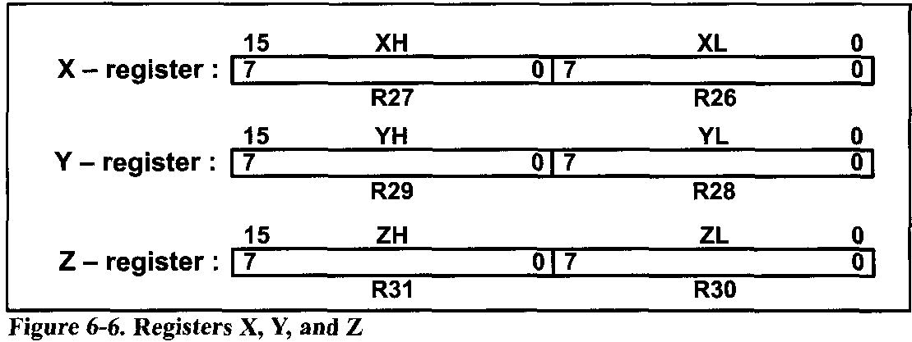
AVR ADVANCED ASSEMBLY LANGUAGE PROGRAMMING 6.3 REGISTER INDIRECT ADDRESSING MODE
Register indirect addressing mode
In the register indirect addressing mode, a register is used as a pointer to the data memory location. In the AVR, three registers are used for this purpose: X, Y, and Z. These are 16-bit registers allowing access to the entire 65,536 bytes of data memory space in the AVR.

Slide 25
AVR ADVANCED ASSEMBLY LANGUAGE PROGRAMMING 6.3 REGISTER INDIRECT ADDRESSING MODE
We can use them with the LD instruction to read the value of a location pointed to by these registers. For example, the following instruction reads the value of the location pointed to by the X pointer.
For instance, the following program loads the contents of location 0x130 into R18:

Slide 26
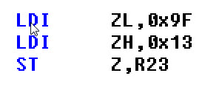
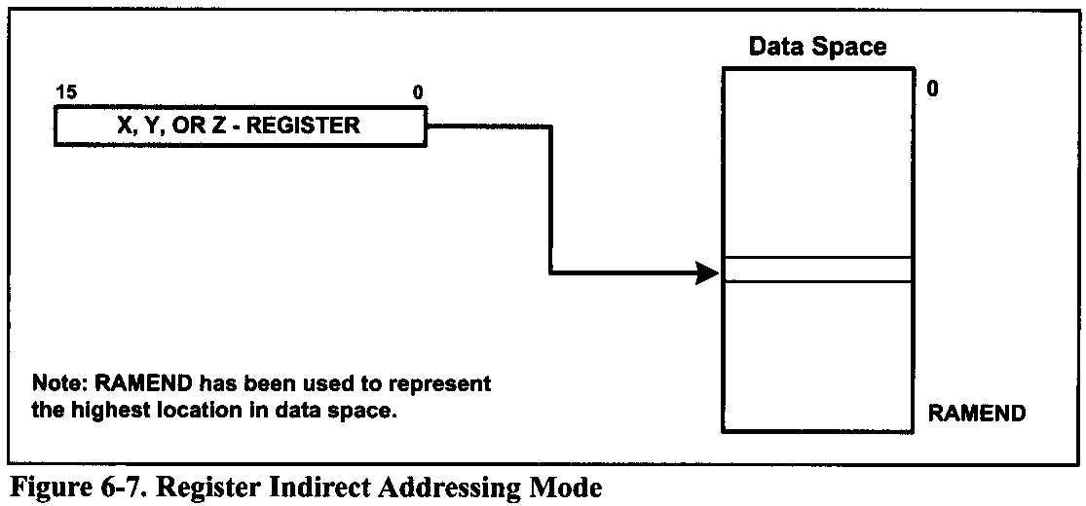
AVR ADVANCED ASSEMBLY LANGUAGE PROGRAMMING 6.3 REGISTER INDIRECT ADDRESSING MODE
The ST instruction can be used to write a value to a location to which any of the X, Y, and Z registers points. For example, the following program stores the contents of R23 into location 0x139F:

Slide 27
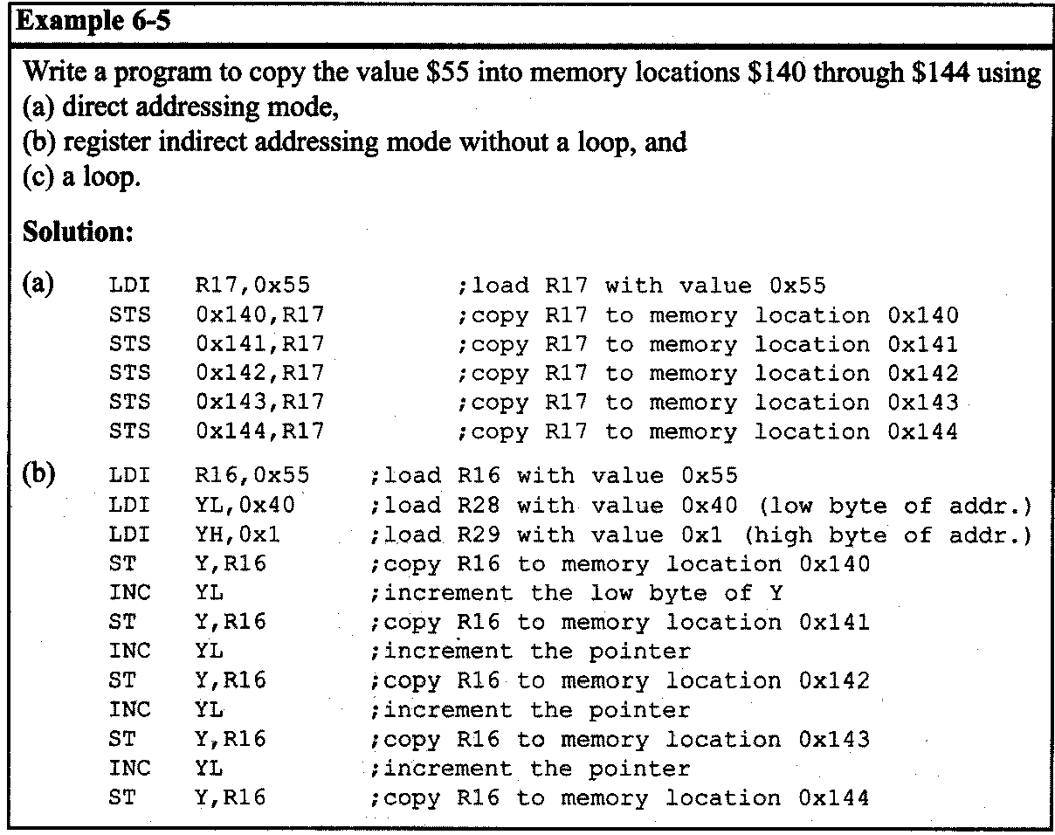
AVR ADVANCED ASSEMBLY LANGUAGE PROGRAMMING 6.3 REGISTER INDIRECT ADDRESSING MODE
Advantages of register indirect addressing mode
One of the advantages of register indirect addressing mode is that it makes accessing data dynamic rather than static, as with direct addressing mode.

Slide 28
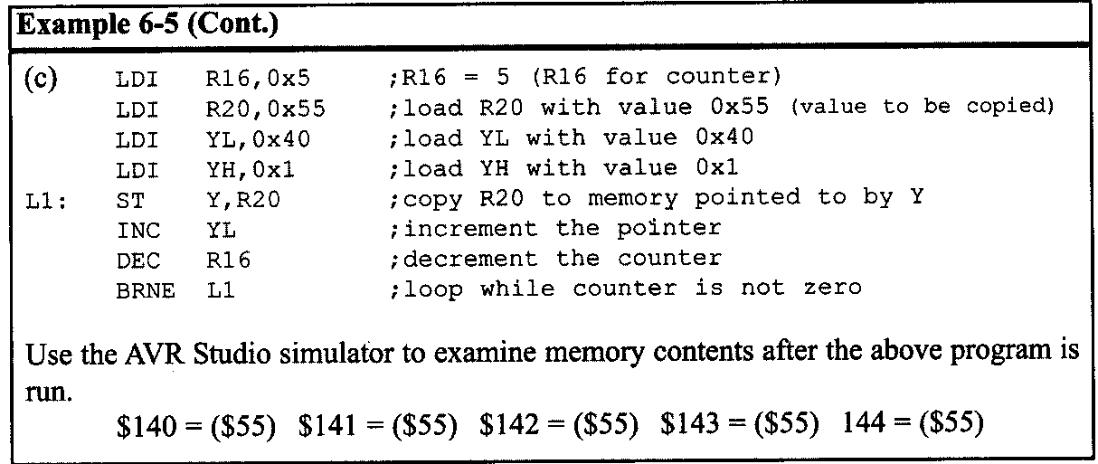
AVR ADVANCED ASSEMBLY LANGUAGE PROGRAMMING 6.3 REGISTER INDIRECT ADDRESSING MODE

Slide 29
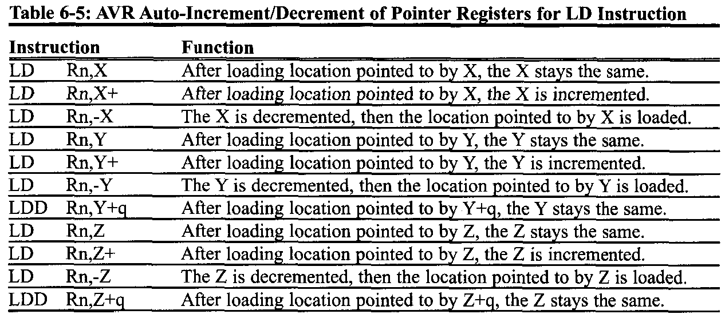
AVR ADVANCED ASSEMBLY LANGUAGE PROGRAMMING 6.3 REGISTER INDIRECT ADDRESSING MODE
Auto-increment and auto-decrement options for pointer registers
Because the pointer registers (X, Y, and Z) are 16-bit registers, they can go from $0000 to $FFFF, which covers the entire 64K memory space of the AVR. Using the “INC ZL” instruction to increment the pointer can cause a problem.

Slide 30
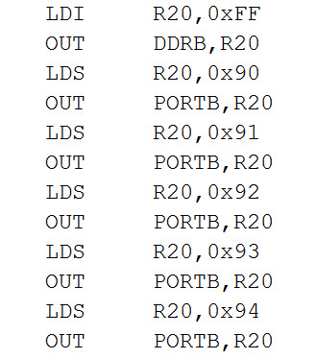
AVR ADVANCED ASSEMBLY LANGUAGE PROGRAMMING 6.3 REGISTER INDIRECT ADDRESSING MODE
Example 6-6
Assume that RAM location $90-$94 have string of ASCII data, as shown below:
$90 = (‘H’) $91 = (‘E’) $92 = (‘L’) $93 = (‘L’) $94 = (‘O’)
Write a program to get each character and send it to PORT B one byte at a time. Show the program using :
Direct Accessing mode.
Register indirect addressing mode.
Solution:
(a) Using direct Addressing mode

Slide 31
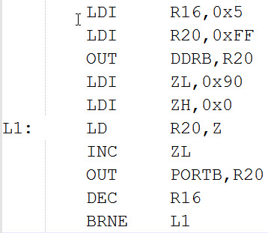
AVR ADVANCED ASSEMBLY LANGUAGE PROGRAMMING 6.3 REGISTER INDIRECT ADDRESSING MODE
(b) Using Register indirect addressing mode
When simulating the above program on the AVR Studio, make sure memory location $90-$94 have the message “HELLO”

Slide 32
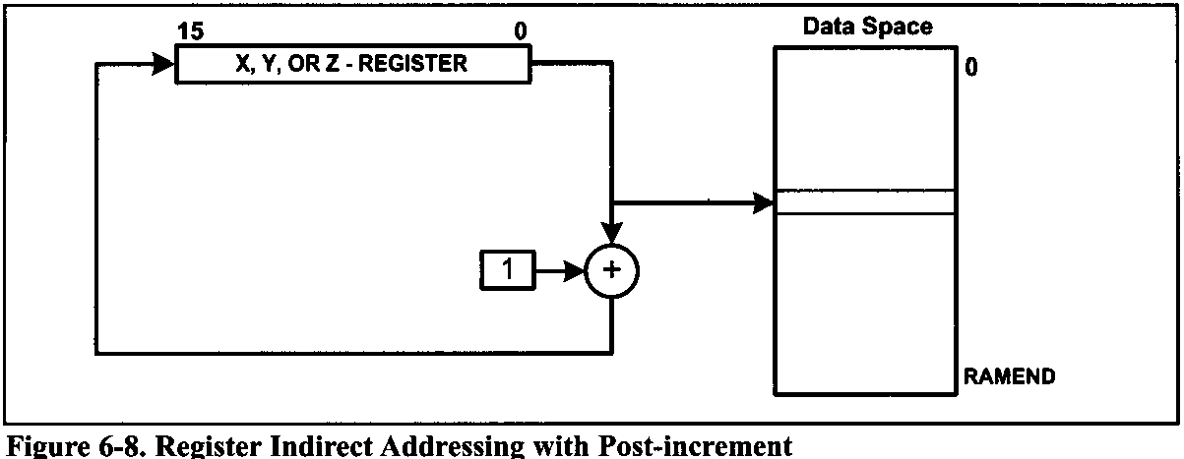
AVR ADVANCED ASSEMBLY LANGUAGE PROGRAMMING 6.3 REGISTER INDIRECT ADDRESSING MODE

Slide 33
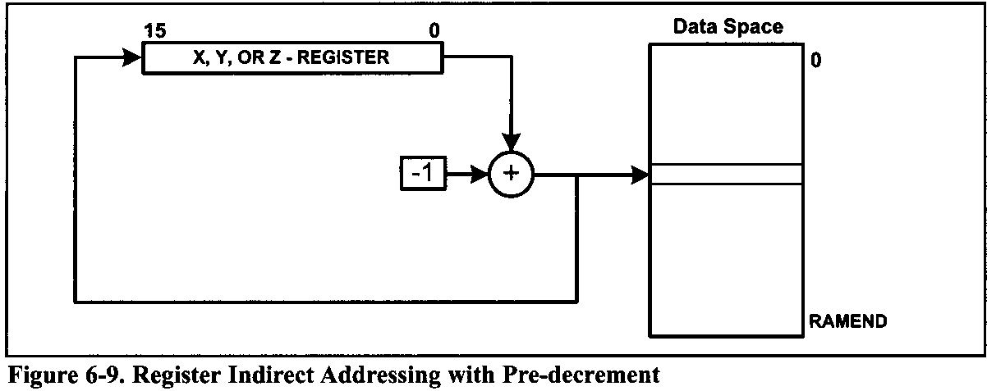
AVR ADVANCED ASSEMBLY LANGUAGE PROGRAMMING 6.3 REGISTER INDIRECT ADDRESSING MODE

Slide 34
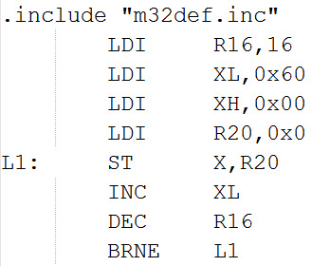
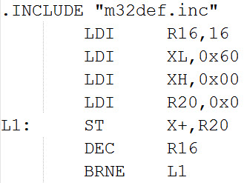
AVR ADVANCED ASSEMBLY LANGUAGE PROGRAMMING 6.3 REGISTER INDIRECT ADDRESSING MODE
Write a program to clear 16 memory location starting at data memory address $60. Use the following:
INC Rn
Auto-increment

Slide 35
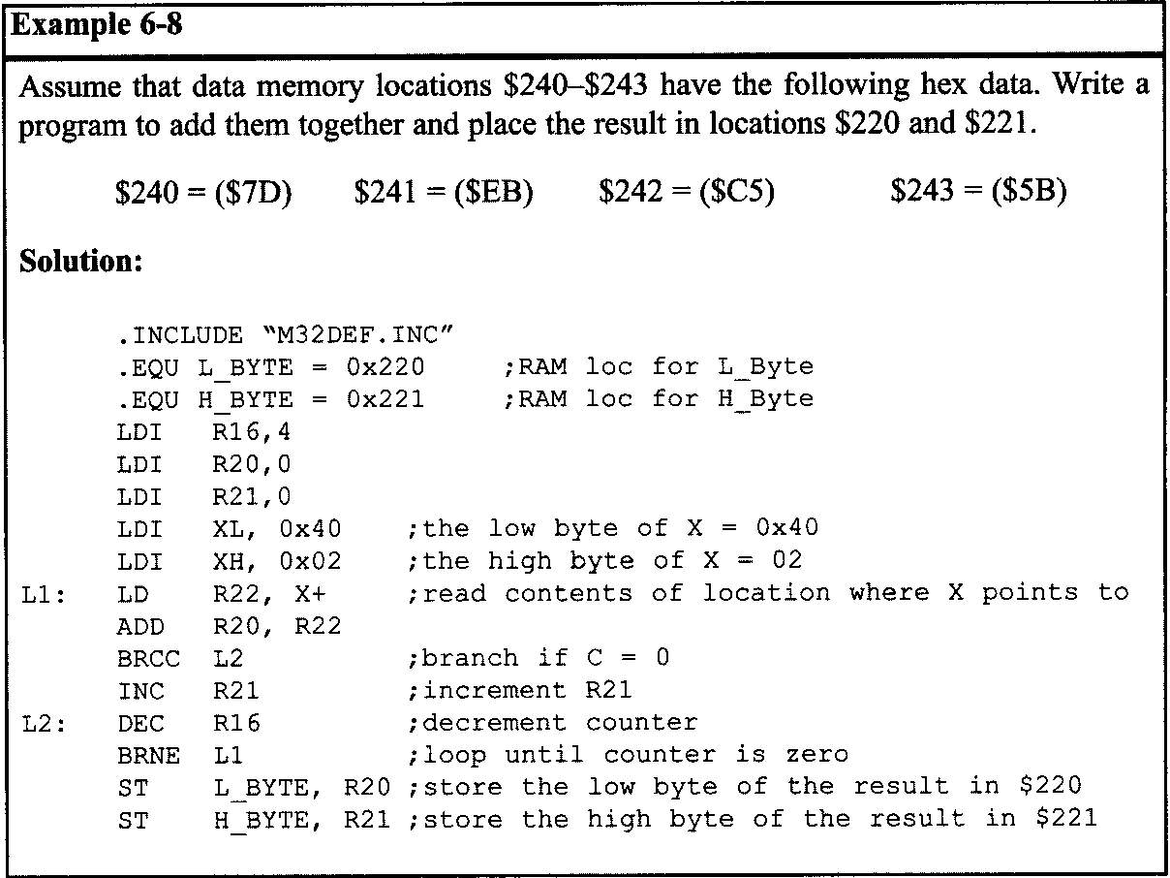
AVR ADVANCED ASSEMBLY LANGUAGE PROGRAMMING 6.3 REGISTER INDIRECT ADDRESSING MODE

Slide 36
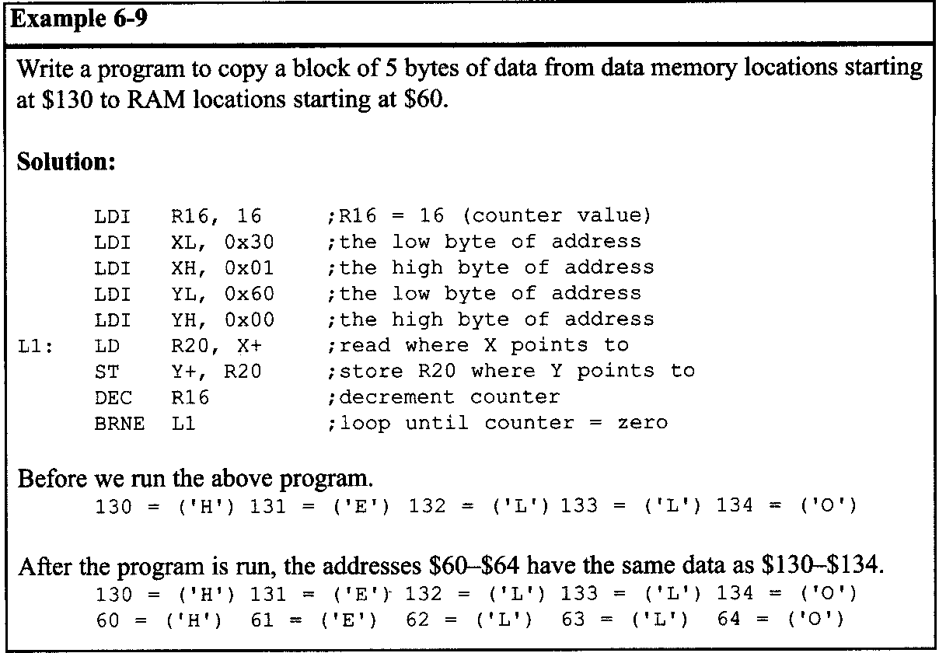
AVR ADVANCED ASSEMBLY LANGUAGE PROGRAMMING 6.3 REGISTER INDIRECT ADDRESSING MODE

Slide 37
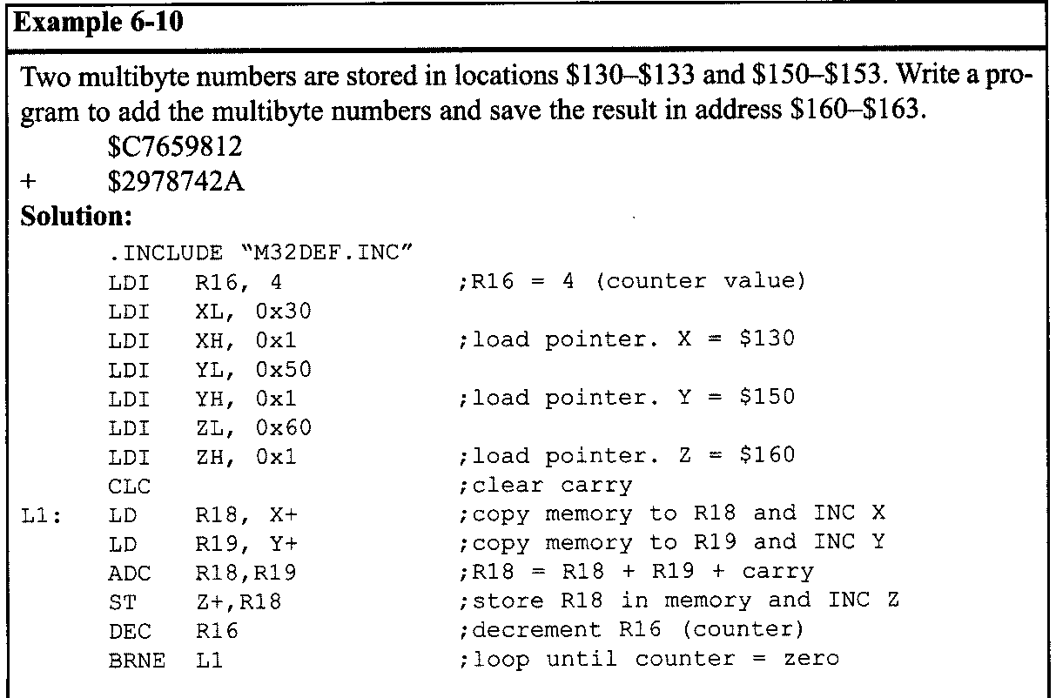
AVR ADVANCED ASSEMBLY LANGUAGE PROGRAMMING 6.3 REGISTER INDIRECT ADDRESSING MODE

Slide 38
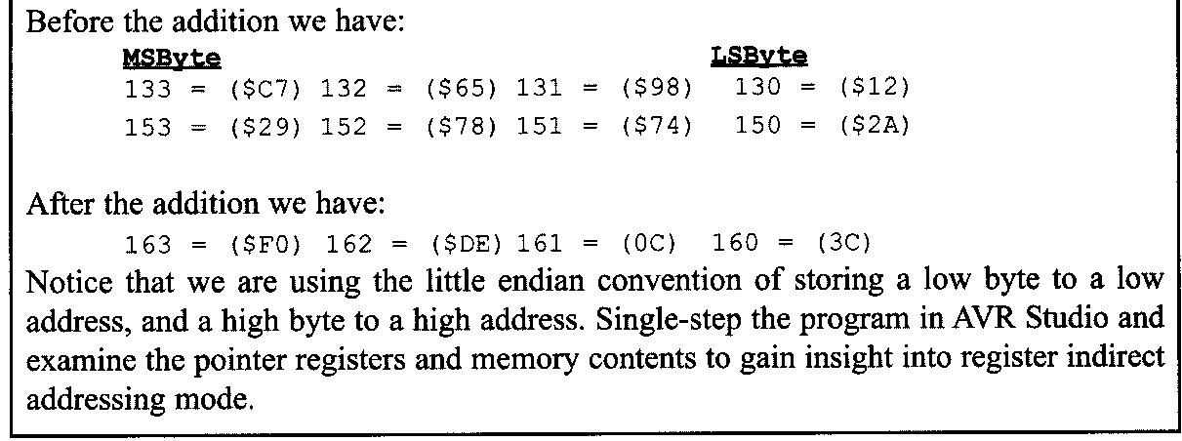
AVR ADVANCED ASSEMBLY LANGUAGE PROGRAMMING 6.3 REGISTER INDIRECT ADDRESSING MODE

Slide 39
AVR ADVANCED ASSEMBLY LANGUAGE PROGRAMMING 6.3 REGISTER INDIRECT ADDRESSING MODE
Register indirect with displacement
Suppose we want to read a byte that is a few bytes higher than where the Z register points to. To do so we can increment the Z register so that it points to the desired location and then read it. But there is an easier way; we can use the register indirect with displacement. In this addressing mode a fixed number is added to the Z register. For example, if we want to read from the location that is 5 bytes after the location to which Z points, we can write the following instruction:
The general format of the instruction is as follows:
where q is a number between 0 to 63, and Rd is any of the general purpose registers.

Slide 40
AVR ADVANCED ASSEMBLY LANGUAGE PROGRAMMING 6.3 REGISTER INDIRECT ADDRESSING MODE
To store a byte of data in a data memory location using the register indirect with displacement addressing mode we can use STD (Store with Displacement). The instruction is as follows:
For example, the following instruction writes the contents of R20 into the location that is five bytes away from where Z points to:

Slide 41
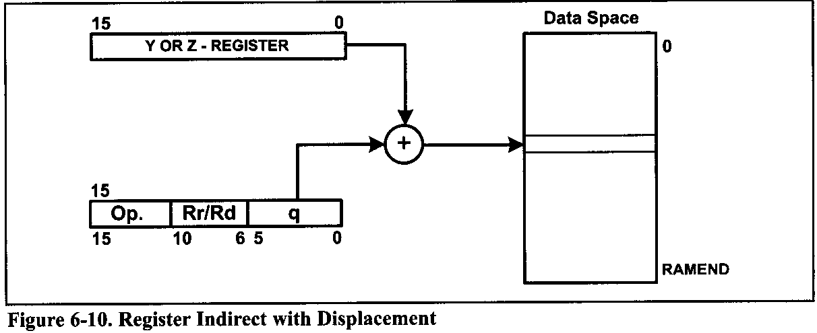
AVR ADVANCED ASSEMBLY LANGUAGE PROGRAMMING 6.3 REGISTER INDIRECT ADDRESSING MODE

Slide 42
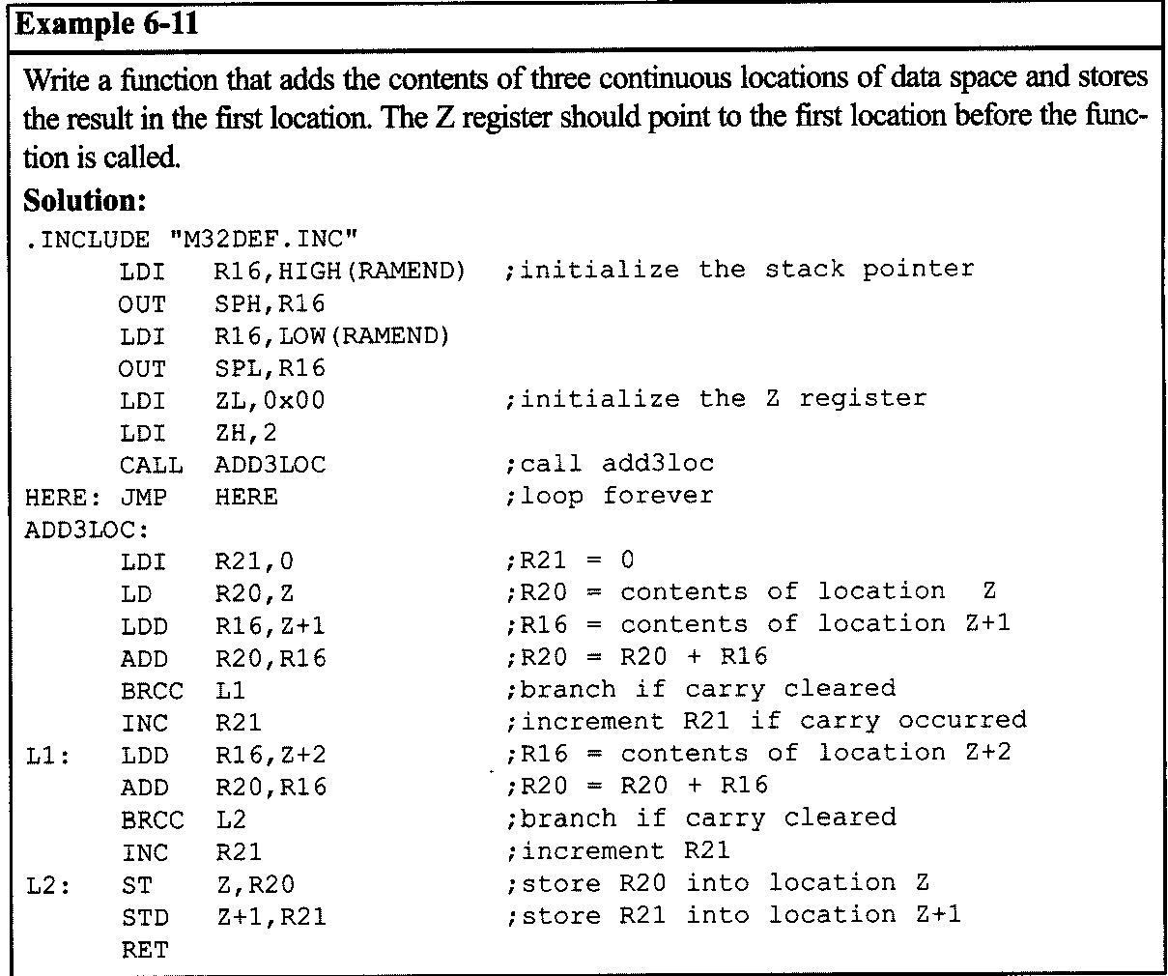
AVR ADVANCED ASSEMBLY LANGUAGE PROGRAMMING 6.3 REGISTER INDIRECT ADDRESSING MODE

Slide 43
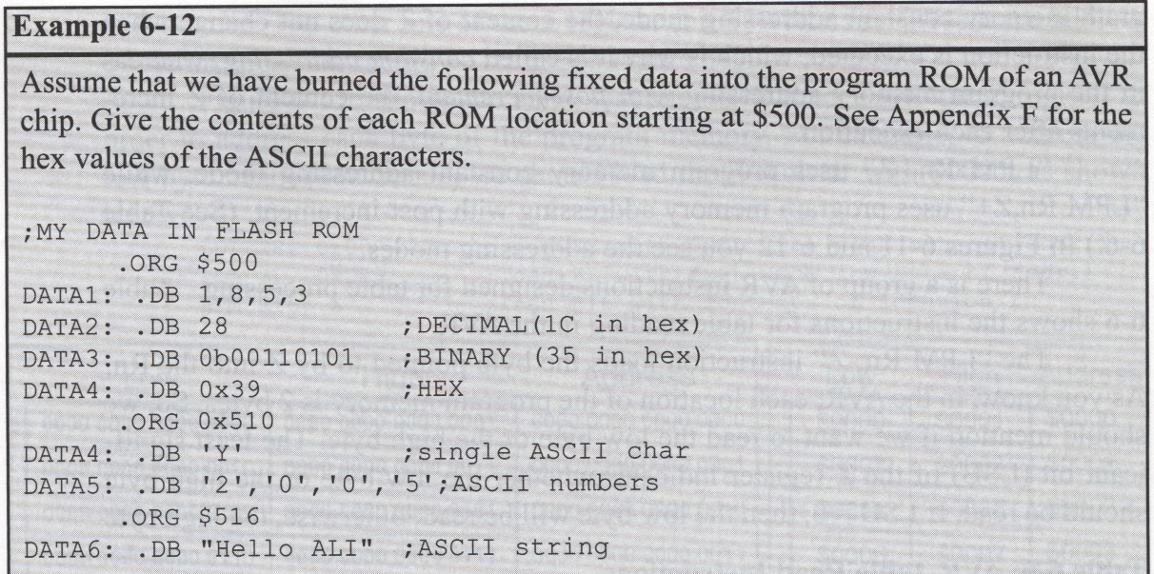
AVR ADVANCED ASSEMBLY LANGUAGE PROGRAMMING 6.4 LOOK-UP TABLE AND TABLE PROCESSING
.DB (define byte) and fixed data in program ROM
The .DB data directive is widely used to allocate ROM program (code) memory in byte-sized chunks. When .DB is used to define fixed data, the numbers can be in decimal, binary, hex, or ASCII formats. The .DB directive is widely used to define ASCII strings.

Slide 44
AVR ADVANCED ASSEMBLY LANGUAGE PROGRAMMING 6.4 LOOK-UP TABLE AND TABLE PROCESSING
.DB (define byte) and fixed data in program ROM
In Example 6-12 notice that each location of program memory is 2 bytes, whereas the . DB directive allocates byte-sized chunks. If we allocate a few bytes of data using the . DB directive, the first byte goes to the low byte of ROM location; the second byte goes to the high byte of ROM location; the third byte goes to the low byte of the next location of program ROM; and so on.
In the cases in which we allocate an odd number of ROM locations using . DB, the assembler will automatically make the number of allocated locations even by placing a zero into the high byte of the last location.
In Example 6-12 notice also that we must use single quotes (') for a single character and double quotes (") for a string.

Slide 45
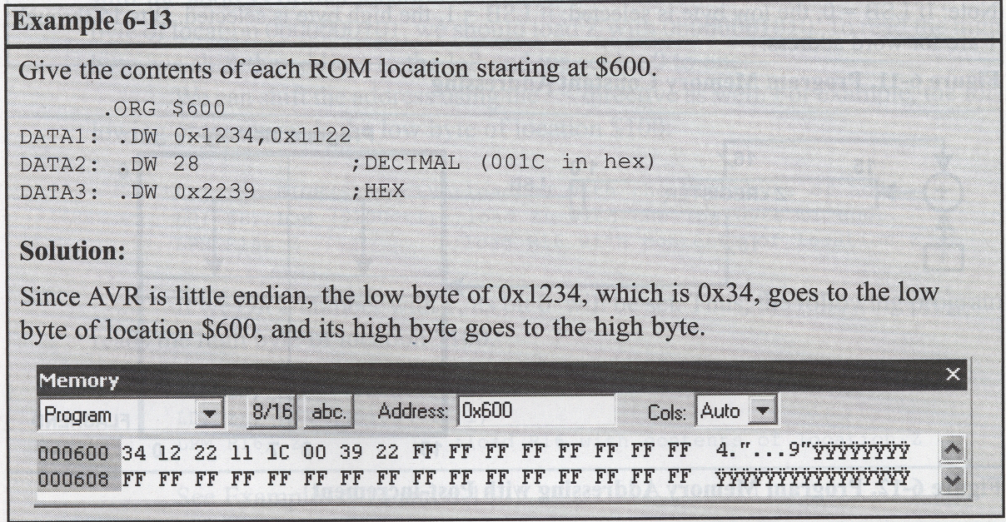
AVR ADVANCED ASSEMBLY LANGUAGE PROGRAMMING 6.4 LOOK-UP TABLE AND TABLE PROCESSING
AVR assembly also allows the use of .DW in place of . DB to define values greater than 255 (0xFF) but not larger than 65,535 (0xFFFF).

Slide 46
AVR ADVANCED ASSEMBLY LANGUAGE PROGRAMMING 6.4 LOOK-UP TABLE AND TABLE PROCESSING
Reading table elements in the AVR
Now, we need to have a register pointer to point to the data to be fetched from the code space. The Z register can be used for this purpose. For this reason we can call it register indirect flash addressing mode.
In AVR terminology, there are two register indirect flash addressing modes:
program memory constant addressing
and
program memory addressing with post-increment.
In the program memory constant addressing mode, the content of Z does not change when the instruction is executed, which is why is called constant addressing; whereas in the program memory addressing with post-increment, the content of Z increments after each execution.

Slide 47
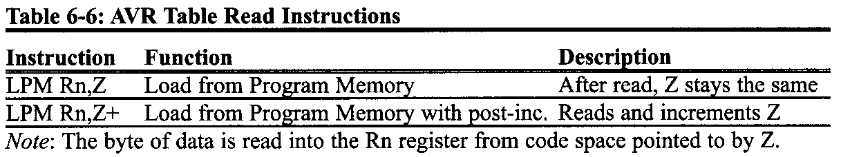
AVR ADVANCED ASSEMBLY LANGUAGE PROGRAMMING 6.4 LOOK-UP TABLE AND TABLE PROCESSING
The Instruction
“LPM Rn,Z”
uses program memory constant addressing mode, while
“LPM Rn,Z+”
uses program memory addressing with post-increment.
There is a group of AVR instructions designed for table processing. Table 6.6 shows the instructions for table reading in the AVR.

Slide 48
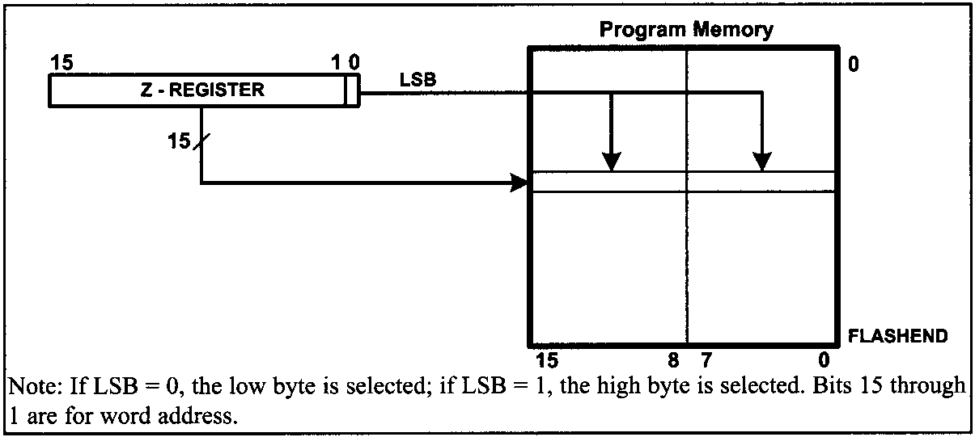
AVR ADVANCED ASSEMBLY LANGUAGE PROGRAMMING 6.4 LOOK-UP TABLE AND TABLE PROCESSING
As you know, in the AVR, each location of the program memory is 2 bytes. So, we should mention if we want to read the low byte or the high byte. The least significant bit (LSB) of the Z register indicates whether the low byte or the high byte should be read.

Slide 49
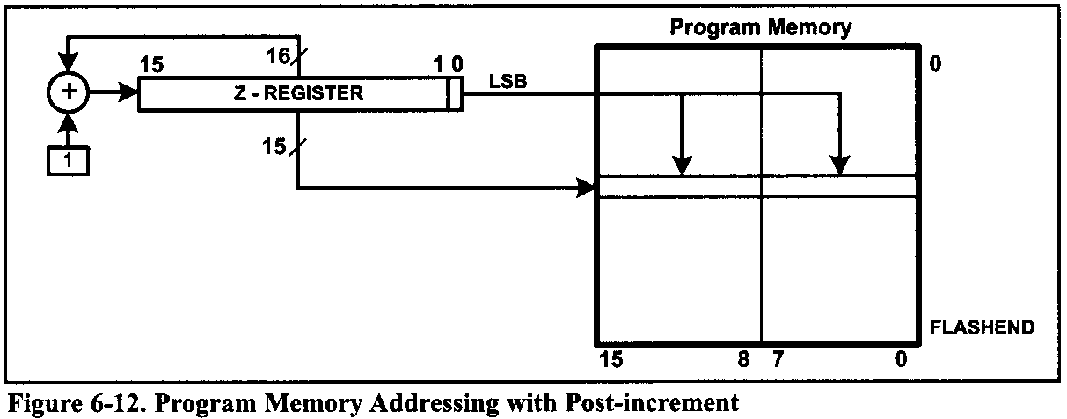
AVR ADVANCED ASSEMBLY LANGUAGE PROGRAMMING 6.4 LOOK-UP TABLE AND TABLE PROCESSING

Slide 50
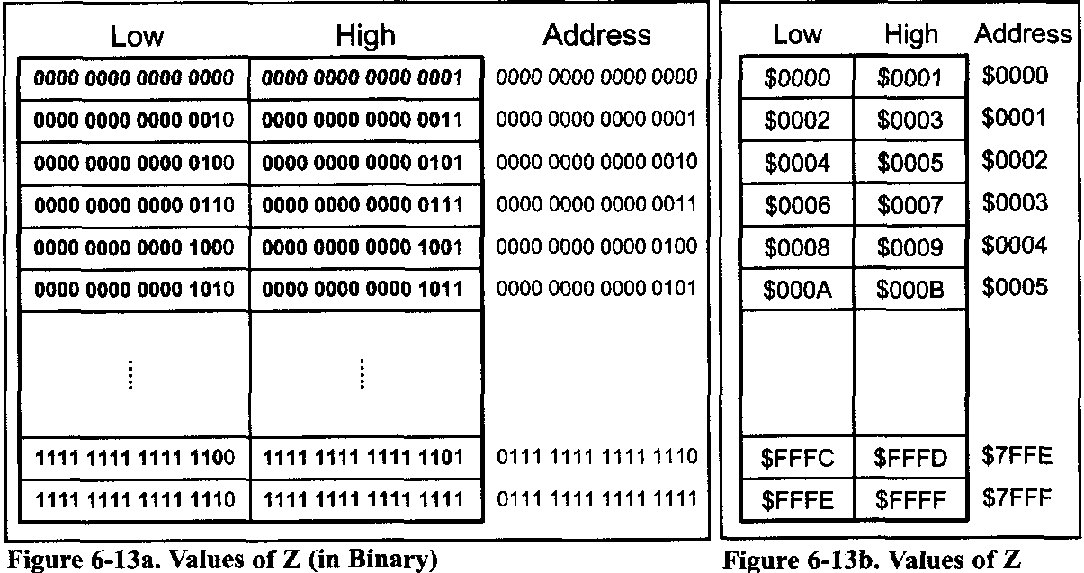
AVR ADVANCED ASSEMBLY LANGUAGE PROGRAMMING 6.4 LOOK-UP TABLE AND TABLE PROCESSING
Figure 6-13b shows the value that should be loaded into the Z register in order to address each byte of the program memory.
For example, to address the low byte of location $0002, we should load the Z register with $0005, as shown below:

Slide 51
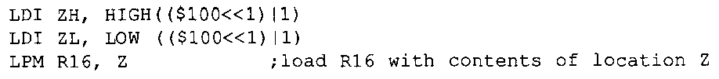
AVR ADVANCED ASSEMBLY LANGUAGE PROGRAMMING 6.4 LOOK-UP TABLE AND TABLE PROCESSING
As you see in Figure 6-13a, to read the low byte of each location we should shift the address of that location one bit to the left. For instance, to access the low byte of location 0b00000101, we should load Z with 0b000001010.
To read the high byte, we shift the address to the left and we set bit 0 to one.
For example, the following program reads the low byte of location $100:
If we OR a number with 1, its bit 0 will be set. Thus, the following program reads the high byte of location $100.

Slide 52
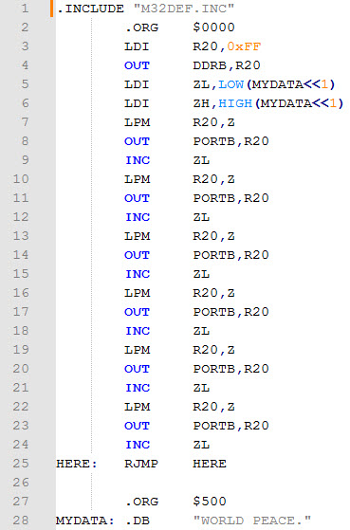
AVR ADVANCED ASSEMBLY LANGUAGE PROGRAMMING 6.4 LOOK-UP TABLE AND TABLE PROCESSING
Example 6-14
In this program, assume that the phrase “WORLD PEACE” is burned into ROM location starting at $500, and the program is burned into ROM locations starting at 0. Analyze how program works and state where “WORLD PEASE.” is stored after this program is run.

Slide 53

AVR ADVANCED ASSEMBLY LANGUAGE PROGRAMMING 6.4 LOOK-UP TABLE AND TABLE PROCESSING

Slide 54

AVR ADVANCED ASSEMBLY LANGUAGE PROGRAMMING 6.4 LOOK-UP TABLE AND TABLE PROCESSING
Example 6-15
Assuming that program ROM space starting at $500 contains “WORLD PEACE.”. Write a program to send characters to Port B one byte at a time.

Slide 55

AVR ADVANCED ASSEMBLY LANGUAGE PROGRAMMING 6.4 LOOK-UP TABLE AND TABLE PROCESSING

Slide 56

AVR ADVANCED ASSEMBLY LANGUAGE PROGRAMMING 6.4 LOOK-UP TABLE AND TABLE PROCESSING
Auto-increment option for Z
Using the "INC ZL" instruction to increment the pointer can cause a problem when an address such as $5FF is incremented. The carry will not propagate into ZH. The AVR gives us the option of LPM Rn, Z+ (load program memory with post-increment) as shown in Table 6-6.
Example 6-16

Slide 57

AVR ADVANCED ASSEMBLY LANGUAGE PROGRAMMING 6.4 LOOK-UP TABLE AND TABLE PROCESSING
Example 6-17
Assume that ROM space starting at $100 contains the message “The Promise of World Peace”. Write a program to bring this message into the CPU one byte at a time and place the byte in Ram locations starting at $140.

Slide 58
AVR ADVANCED ASSEMBLY LANGUAGE PROGRAMMING 6.4 LOOK-UP TABLE AND TABLE PROCESSING
Look-up table
The look-up table is a widely used concept in microcontroller programming. It allows access to elements of a frequently used table with minimum operations. As an example, assume that for a certain application we need 4+x² values in the range of 0 to 9. We can use a look-up table instead of calculating the values, which takes some time. In the AVR, to get the table element we add the index to the address of the look-up table. This is shown in Examples 6-18 through 6-20.

Slide 59


AVR ADVANCED ASSEMBLY LANGUAGE PROGRAMMING 6.4 LOOK-UP TABLE AND TABLE PROCESSING
Example 6-18
Assume that the lower three bits of Port C are connect to three switches. Write a program to send the following ASCII characters to Port D based on the status of the switches.

Slide 60

AVR ADVANCED ASSEMBLY LANGUAGE PROGRAMMING 6.4 LOOK-UP TABLE AND TABLE PROCESSING
Example 6-19
Write a program to get the x value from Port B and sends x² to Port C. Assume that PB3-PB0 has x value of 0-9. use a lookup table instead of a multiply instruction.

Slide 61

AVR ADVANCED ASSEMBLY LANGUAGE PROGRAMMING 6.4 LOOK-UP TABLE AND TABLE PROCESSING
Example 6-20
Write a program to get the x value from Port B and send x²+2x+3 to Port C. Assume PB3-PB0 has the x value of 0-9. Use a look-up table instead of a multiply instruction.

Slide 62
AVR ADVANCED ASSEMBLY LANGUAGE PROGRAMMING 6.4 LOOK-UP TABLE AND TABLE PROCESSING
Accessing a look-up table in RAM
The look-up table elements can also be in RAM instead of ROM. Sometimes we need to bring in the elements of the look-up table from RAM because the elements are dynamic and can change. In the AVR, we can do that using the pointers.
Writing table elements in AVR
In AVR we also have the SPM instruction, which allows us to write (store) data into program memory.

Slide 63

AVR ADVANCED ASSEMBLY LANGUAGE PROGRAMMING 6.5 BIT-ADDRESSABILITY
In this section, we provide more programming examples of bit manipulation using the bit-addressable and byte-addressable options of the AVR family.
In Table 6-7, some of the bit-oriented instructions are given. Notice that the bit-oriented instructions use only one addressing mode, the direct addressing mode.

Slide 64

AVR ADVANCED ASSEMBLY LANGUAGE PROGRAMMING 6.5 BIT-ADDRESSABILITY
Manipulating the bits of general purpose registers
Setting the bits
The SBR (Set Bits in Register) instruction sets the specified bits in the general purpose register. It has the following format:

Slide 65
AVR ADVANCED ASSEMBLY LANGUAGE PROGRAMMING 6.5 BIT-ADDRESSABILITY
For example, in the following program the SBR instruction sets the bits 2, 5, and 6 regardless of their previous values.
When execution of the above instructions is finished, R17 contains 0x7D. Notice that the SBR instruction is a byte-oriented instruction as it manipulates the whole byte at one time.

Slide 66

AVR ADVANCED ASSEMBLY LANGUAGE PROGRAMMING 6.5 BIT-ADDRESSABILITY
Clearing the bits
The CBR (Clear Bits in Register) instruction clears the specified bits in the general purpose register. It has the following format:

Slide 67
AVR ADVANCED ASSEMBLY LANGUAGE PROGRAMMING 6.5 BIT-ADDRESSABILITY
For example, in the following program the CBR instruction clears the bits 2, 5, and 6 regardless of their previous values.
After the execution of the above instructions, R17 contains 0x19.

Slide 68

AVR ADVANCED ASSEMBLY LANGUAGE PROGRAMMING 6.5 BIT-ADDRESSABILITY
Copying a bit
As we saw in Chapter 2, one of the bits in the SREG (status register) is named T (temporary), which is used when we want to copy a bit of data from one GPR to another GPR.
Notes:
As we saw in Chapter 2, one of the bits in the SREG (status register) is named T (temporary), which is used when we want to copy a bit of data from one GPR to another GPR. The BST (Bit Store from register to T) and BLD (Bit Load from T to register) instructions can be used to copy a bit of a register to a specific bit of another register. The "BST Rd, b" instruction stores bit b from Rd to the T flag, while the "BLD R r , b" instruction copies the T flag to bit b in register Rr.

Slide 69


AVR ADVANCED ASSEMBLY LANGUAGE PROGRAMMING 6.5 BIT-ADDRESSABILITY
For example, the following program copies bit 3 from R17 to bit 5 in register R19:

Slide 70

AVR ADVANCED ASSEMBLY LANGUAGE PROGRAMMING 6.5 BIT-ADDRESSABILITY

Slide 71


AVR ADVANCED ASSEMBLY LANGUAGE PROGRAMMING 6.5 BIT-ADDRESSABILITY
For example, in the following program the "LDI R20,0x55" instruction will not be executed since bit 3 of R17 is set.

Slide 72


AVR ADVANCED ASSEMBLY LANGUAGE PROGRAMMING 6.5 BIT-ADDRESSABILITY
For example, in the following program the "LDI R20, 0x55" instruction will not be executed since bit 2 of R16 is cleared.

Slide 73

AVR ADVANCED ASSEMBLY LANGUAGE PROGRAMMING 6.5 BIT-ADDRESSABILITY
Example 6-22
A switch is connected to pin PC7. Using the SBRS instruction, write a program to check the status of the switch and perform the following:

Slide 74

AVR ADVANCED ASSEMBLY LANGUAGE PROGRAMMING 6.5 BIT-ADDRESSABILITY
Manipulating the bits of I/O registers
As discussed before, we can set and clear the lower 32 I/O registers (addresses 0 to 31) using the SBI (Set bit in 1/O register) and CBI (Clear bit in I/O register) instructions. For example, the following two instructions set the PORTA. 1 and clear the PORTB.4, respectively:

Slide 75

AVR ADVANCED ASSEMBLY LANGUAGE PROGRAMMING 6.5 BIT-ADDRESSABILITY
Example 6-23
Write a program to toggle PB2 a total of 200 times.

Slide 76


AVR ADVANCED ASSEMBLY LANGUAGE PROGRAMMING 6.5 BIT-ADDRESSABILITY
Status register bit-addressability
Checking a flag bit

Slide 77

AVR ADVANCED ASSEMBLY LANGUAGE PROGRAMMING 6.5 BIT-ADDRESSABILITY
For

Slide 78


AVR ADVANCED ASSEMBLY LANGUAGE PROGRAMMING 6.5 BIT-ADDRESSABILITY
For example, in the following program the LDI instruction is not executed when the carry flag is set:
We can write the same program using the "BRCS LI" instruction as follows:

Slide 79

AVR ADVANCED ASSEMBLY LANGUAGE PROGRAMMING 6.5 BIT-ADDRESSABILITY
Manipulating a bit

Slide 80

AVR ADVANCED ASSEMBLY LANGUAGE PROGRAMMING 6.5 BIT-ADDRESSABILITY

Slide 81


AVR ADVANCED ASSEMBLY LANGUAGE PROGRAMMING 6.5 BIT-ADDRESSABILITY
For

Slide 82

AVR ADVANCED ASSEMBLY LANGUAGE PROGRAMMING 6.5 BIT-ADDRESSABILITY
A more convenient way is to use the CLZ instruction, as shown in Table 6-9.

Slide 83
AVR ADVANCED ASSEMBLY LANGUAGE PROGRAMMING 6.5 BIT-ADDRESSABILITY
Internal RAM bit-addressability
The internal RAM is not bit-addressable.
So, in order to manipulate a bit of the internal RAM location, you should bring it into the general purpose register and then manipulate it, as shown in Examples .
Example 6-25
Write a program to see if the internal RAM location $195 contains an even value. If so, send it to Port B. If not, make it even and then send it to Port B.

Slide 84

AVR ADVANCED ASSEMBLY LANGUAGE PROGRAMMING 6.5 BIT-ADDRESSABILITY
For

Slide 85

AVR ADVANCED ASSEMBLY LANGUAGE PROGRAMMING 6.5 BIT-ADDRESSABILITY
For

Slide 86

AVR ADVANCED ASSEMBLY LANGUAGE PROGRAMMING 6.6 ACCESSING EEPROM IN AVR
6.6 ACCESSING EEPROM IN AVR
The data in SRAM will be lost if the power is disconnected. However, we need a place to save our data to protect them against power failure. EEPROM memory can save stored data even when the power is cut off. In this section we will show how to write to EEPROM memory and how to access it.

Slide 87
AVR ADVANCED ASSEMBLY LANGUAGE PROGRAMMING 6.6 ACCESSING EEPROM IN AVR
EEPROM registers
There are three I/O registers that are directly related to EEPROM. These are EECR (EEPROM Control Register), EEDR (EEPROM Data Register), and EEARH-EEARL (EEPROM Address Register High-Low). Each of these registers is discussed in detail in this section.
EEPROM Data Register (EEDR)
To write data to EEPROM, you have to write it to the EEDR register and then transfer it to EEPROM. Also, if you want to read from EEPROM you have to read from EEDR. In other words, EEDR is a bridge between EEPROM and CPU.

Slide 88

AVR ADVANCED ASSEMBLY LANGUAGE PROGRAMMING 6.6 ACCESSING EEPROM IN AVR
EEPROM Address Register (EEARH and EEARL)
The EEARH:EEARL registers together make a 16-bit register to address each location in EEPROM memory space. When you want to read from or write to EEPROM, you should load the EEPROM location address in EEARs. As you see in Figure 6-15, only 10 bits of the EEAR registers are used in ATmega32. Because ATmega32 has 1024-byte EEPROM locations, we need 10 bits to address each location in EEPROM space

Slide 89

AVR ADVANCED ASSEMBLY LANGUAGE PROGRAMMING 6.6 ACCESSING EEPROM IN AVR
EEPROM Control Register (EECR)
The EECR register is used to select the kind of operation to perform on. The operation can be start, read, and write. In Figure 6-16 you see the bits of the EECR register. The bits are as follows:
EEPROM Read Enable (EERE): Setting this bit to one will cause a read operation if EEWE is zero. When a read operation starts, one byte of EEPROM will be read into the EEPROM Data Register (EEDR). The EEAR register specifies the address of the desired byte.
Notes:
EEPROM Read Enable (EERE): Setting this bit to one will cause a read operation if EEWE is zero. When a read operation starts, one byte of EEPROM will be read into the EEPROM Data Register (EEDR). The EEAR register specifies the address of the desired byte.

Slide 90
AVR ADVANCED ASSEMBLY LANGUAGE PROGRAMMING 6.6 ACCESSING EEPROM IN AVR
EEPROM Write Enable (EEWE) and EEPROM Master Write Enable (EEMWE): When EEMWE is set, setting EEWE within four clock cycles will start a write operation. If EEMWE is zero, setting EEWE to one will have no effect.
When you set EEMWE to one, the hardware clears the bit to zero after four clock cycles. This prevents unwanted write operations on EEPROM contents. Notice that you cannot start read or write operations before the last write operation is finished. You can check for this by polling the EEWE bit. If EEWE is zero it means that EEPROM is ready to start a new read or write operation.
EEPROM Ready Interrupt Enable (EERIE): In Chapter 10 you will learn about interrupts in AVR.
As you see in Figure 6- 16, bits 4 to 7 of EECR are unused at the present time and are reserved.

Slide 91
AVR ADVANCED ASSEMBLY LANGUAGE PROGRAMMING 6.6 ACCESSING EEPROM IN AVR
Programming the AVR to write on EEPROM
To write on EEPROM the following steps should be followed. Notice that steps 2 and 3 are optional, and the order of the steps is not important. Also note that you cannot do anything between step 4 and step 5 because the hardware clears the EEMWE bit to zero after four clock cycles.
Wait until EEWE becomes zero.
Write new EEPROM address to EEAR (optional).
Write new EEPROM data to EEDR (optional).
Set the EEMWE bit to one (in EECR register).
Within four clock cycles after setting EEMWE, set EEWE to one.
See Example 6-28 to see how we write a byte on EEPROM.

Slide 92

AVR ADVANCED ASSEMBLY LANGUAGE PROGRAMMING 6.6 ACCESSING EEPROM IN AVR

Slide 93
AVR ADVANCED ASSEMBLY LANGUAGE PROGRAMMING 6.6 ACCESSING EEPROM IN AVR
Programming the AVR to read from EEPROM
To read from EEPROM the following steps should be taken. Note that step 2 is optional.
Wait until EEWE becomes zero.
Write new EEPROM address to EEAR (optional).
Set the EERE bit to one.
Read EEPROM data from EEDR.
See Example 6-29 to see how we read a byte from EEPROM.

Slide 94

AVR ADVANCED ASSEMBLY LANGUAGE PROGRAMMING 6.6 ACCESSING EEPROM IN AVR

Slide 95

AVR ADVANCED ASSEMBLY LANGUAGE PROGRAMMING 6.6 ACCESSING EEPROM IN AVR
Initializing EEPROM
In Section 6-4, you saw how to allocate program memory using the .DB directive. We can also allocate and initialize the EEPROM using the .DB directive. If we write .ESEG before a definition, the variable will be located in the EEPROM, whereas .CSEG before a definition causes the variable to be allocated in the code (program) memory. By default the variables are located in the program memory. For example, the following code allocates locations $10 and $11 of EEPROM for DATAl and DATA2, and initializes them with $95 and $19, respectively:

Slide 96


AVR ADVANCED ASSEMBLY LANGUAGE PROGRAMMING 6.6 ACCESSING EEPROM IN AVR

Slide 97

AVR ADVANCED ASSEMBLY LANGUAGE PROGRAMMING 6.6 ACCESSING EEPROM IN AVR

Slide 98
AVR ADVANCED ASSEMBLY LANGUAGE PROGRAMMING 6.7 CHECKSUM AND SUNROUTINES
Checksum byte in EEPROM
The checksum will detect any corruption of the contents of ROM. One cause of ROM corruption is current surge, either when the system is turned on, or during operation. To ensure data integrity in ROM, the checksum process uses what is called a checksum byte. The checksum byte is an extra byte that is tagged to the end of a series of bytes of data. To calculate the checksum byte of a series of bytes of data, the following steps can be taken:
Add the bytes together and drop the carries.
Take the 2's complement of the total sum, and that is the checksum byte, which becomes the last byte of the series.
To perform a checksum operation, add all the bytes, including the checksum byte. The result must be zero. If it is not zero, one or more bytes of data have been changed (corrupted).

Slide 99
AVR ADVANCED ASSEMBLY LANGUAGE PROGRAMMING 6.7 CHECKSUM AND SUNROUTINES
Checksum program
The checksum generation and testing program is given in subroutine form. Five subroutines perform the following operations:
Retrieve the data from EEPROM.
Test the checksum byte for any data error.
Initialize variables if the checksum byte is corrupted.
Calculate the checksum byte.
Store the data in EEPROM.
Each of these subroutines can be used in other applications.

Slide 100

AVR ADVANCED ASSEMBLY LANGUAGE PROGRAMMING 6.7 CHECKSUM AND SUNROUTINES
Example 6-31 shows how to manually calculate the checksum for a list of values.

Slide 101

AVR ADVANCED ASSEMBLY LANGUAGE PROGRAMMING 6.7 CHECKSUM AND SUNROUTINES

Slide 102
AVR ADVANCED ASSEMBLY LANGUAGE PROGRAMMING 6.7 CHECKSUM AND SUNROUTINES
BCD to ASCII conversion program
Many RTCs (real-time clocks) provide time and date in BCD format. To display the BCD data on an LCD or a PC screen, we need to convert it to ASCII. Program 6-2
transfers packed BCD data from program ROM to data RAM,
converts packed BCD to ASCII, and
sends the ASCII to port B for display.

Slide 103
AVR ADVANCED ASSEMBLY LANGUAGE PROGRAMMING 6.7 CHECKSUM AND SUNROUTINES
Binary (hex) to ASCII conversion program
Many ADC (analog-to-digital converter) chips provide output data in binary (hex). To display the data on an LCD or PC screen, we need to convert it to ASCII. The code for the binary-to-ASCII conversion is shown in Program 6-3.
Notice that the subroutine gets a byte of 8-bit binary (hex) data from Port B and converts it to decimal digits, and the second subroutine converts the decimal digits to ASCII digits and saves them.
We are saving the low digit in the lower address location and the high digit in higher address location.
This is referred to as the little-endian convention (i.e., low byte to low location, and high byte to high location).

Slide 104
AVR ADVANCED ASSEMBLY LANGUAGE PROGRAMMING 6.8 MACROS
What is a macro and how is it used?
Macros allow the programmer to write the task (code to perform a specific job) once only, and to invoke it whenever it is needed.
Macro definition
Every macro definition must have three parts, as follows:
.MACRO name
………
.ENDMACRO
What goes between the .MACRO and .ENDMACRO directives is called the body of the macro. The name must be unique and must follow Assembly language naming conventions. A macro can take up to 10 parameters. The parameters can be referred to as @0 to @9 in the body of the macro.

Slide 105


AVR ADVANCED ASSEMBLY LANGUAGE PROGRAMMING 6.8 MACROS
For example, moving immediate data into I/O register data RAM is a widely used service, but there is no instruction for that. We can use a macro to do the job as shown in the following code:
The following are three examples of how to use the above macro:
Notes:
The following are three examples of how to use the above macro:

Slide 106

AVR ADVANCED ASSEMBLY LANGUAGE PROGRAMMING 6.8 MACROS
Now examine Program 6-4 to see how to use a macro in a program.

Slide 107
AVR ADVANCED ASSEMBLY LANGUAGE PROGRAMMING 6.8 MACROS
.INCLUDE directive
The .INCLUDE directive allows a programmer to write macros and save them in a file, and later bring them into any program file. For example, assume that the following widely used macros were written and then saved under the filename “MYMACRO1.MAC”.
Assuming that the LOADIO and DELAY macros are saved on a disk under the filename “MYMACRO.MAC”, the .INCLUDE directive can be used to bring this file into any “.asm” file and then the program can call upon any of the macros as many times as needed. When a file includes all macros, the macros are listed at the beginning of the “.lst” file and, as they are expanded, will be part of the program.

Slide 108

AVR ADVANCED ASSEMBLY LANGUAGE PROGRAMMING 6.8 MACROS
To understand this, see Program 6-5.

Slide 109


AVR ADVANCED ASSEMBLY LANGUAGE PROGRAMMING 6.8 MACROS
. LISTMAC directive
Using the .LISTMAC directive we can turn on the display of the bodies of macros in the list file. For example, examine the following code: The assembler provides the following code in the .lst file:
Notes:
When viewing the .lst file with macros, the details of the macros are not displayed. This means that the bodies of the macros are not displayed when they are invoked during the code. But when we are debugging the code we might need to see exactly what instructions are executed.

Slide 110



AVR ADVANCED ASSEMBLY LANGUAGE PROGRAMMING 6.8 MACROS
If we add the .LISTMAC directive to the above code:

